Slide 1
Creating Business Value through Data Presentation
Introduction to Analyzing Data for Business Goals

Slide 2
Learning Goals
Assess different data visualization techniques and discuss their advantages and limitations.
Decide on a method to validate, prepare, and communicate insights to key stakeholders.
Organize data using a pivot table in Excel.
Describe the process of data manipulation and techniques using Excel.

Slide 3
Data Manipulation
Data: collection of facts representing business transactions, experiences, observations, or experiments
Data may come in a variety of forms
  Numbers, letters, words, images, vides, audio files
Data is the lowest level of abstraction to create information and knowledge
  Data - Information - Knowledge
Data is the raw material for business analytics
  “Data is the new oil”

Slide 4
Common Data Types
Structured data
  Numerical [continuous] data
    Interval
    Ratio
  Categorical [discrete] data
    Nominal
    Ordinal
Unstructured [less structured] data
  Textual data
  Multimedia data (Image, video, audio)
  XML/HTML/JSON
Data
Mining
Text
Mining
Media
Mining
Web
Mining

Slide 5
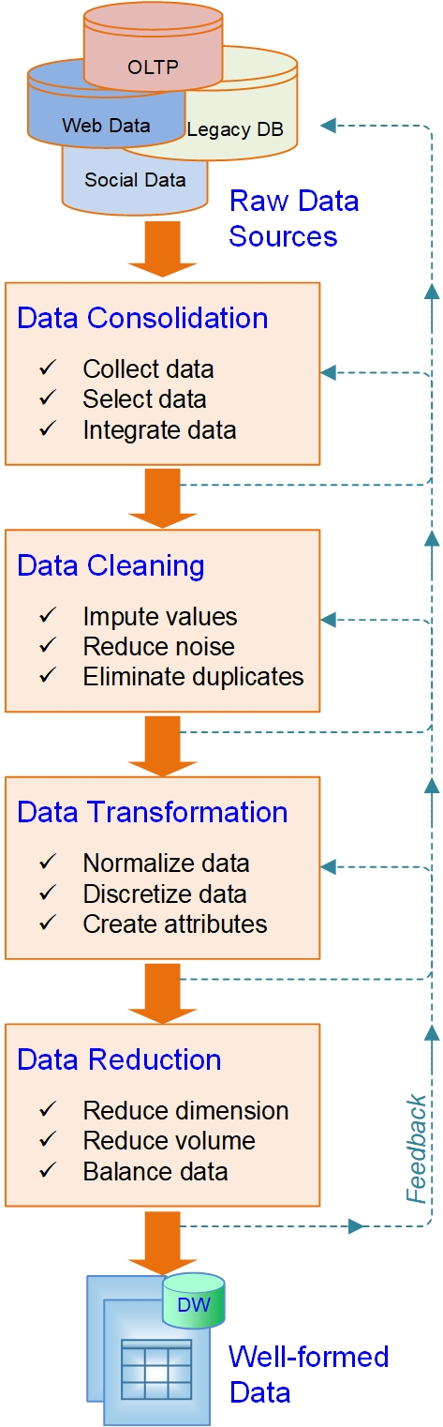
Preprocessing of Data for Analytics
The raw data is
  Dirty…
  Noisy…
  Incomplete…
  Inconsistent…
  Inaccurate…
The GIGO principle
It is a time demanding, multi-step, recursive, and tedious process

Slide 6
Summary of Data Preprocessing Tasks
Main Task | Subtasks | Popular Methods
Data consolidation | Access and collect the data | SQL queries, software agents, Web crawlers, data access APIs
 | Select and filter the data | Domain expertise, SQL queries, statistical tests
 | Integrate and unify the data | SQL queries, domain expertise, ontology-driven data mapping
Data cleaning | Handle missing values in the data | Filling in the missing values (imputations); recoding of the missing values with a constant such as “ML”; removal of the records; etc.
 | Identify and reduce noise in the data | Identification of outliers in data with simple statistical techniques or with cluster analysis; removal of the outliers or smoothing by using binning, regression, or simple averages
 | Find and eliminate erroneous data | Identification of erroneous values in data, such as odd values, inconsistent class labels, odd distributions; use of domain expertise to correct the values or remove the records
Data transformation | Normalize the data | Reduction of the range of values in each numerically valued variable to a standard range (e.g., 0 to 1, -1 to +1) by using a variety of normalization or scaling techniques
 | Discretize or aggregate the data | If needed, conversion of the numeric variables into discrete representations using range- or frequency-based binning techniques; for categorical variables, reduction of unique values
 | Construct new attributes | Derivation of new and more informative variables from the existing ones, using a range of mathematical functions (addition and multiplication or complex combination of transformations)
Data reduction | Reduce number of attributes | Principal component analysis, independent component analysis, chi-square testing, correlation analysis, decision tree induction
 | Reduce number of records | Random sampling, stratified sampling, expert knowledge-driven purposeful sampling
 | Balance skewed data | Oversampling of the less represented or undersampling of the more represented class records

Slide 7
Demo: Tools & Techniques
Topics
Pivoting
Shaping
Grouping

Slide 8
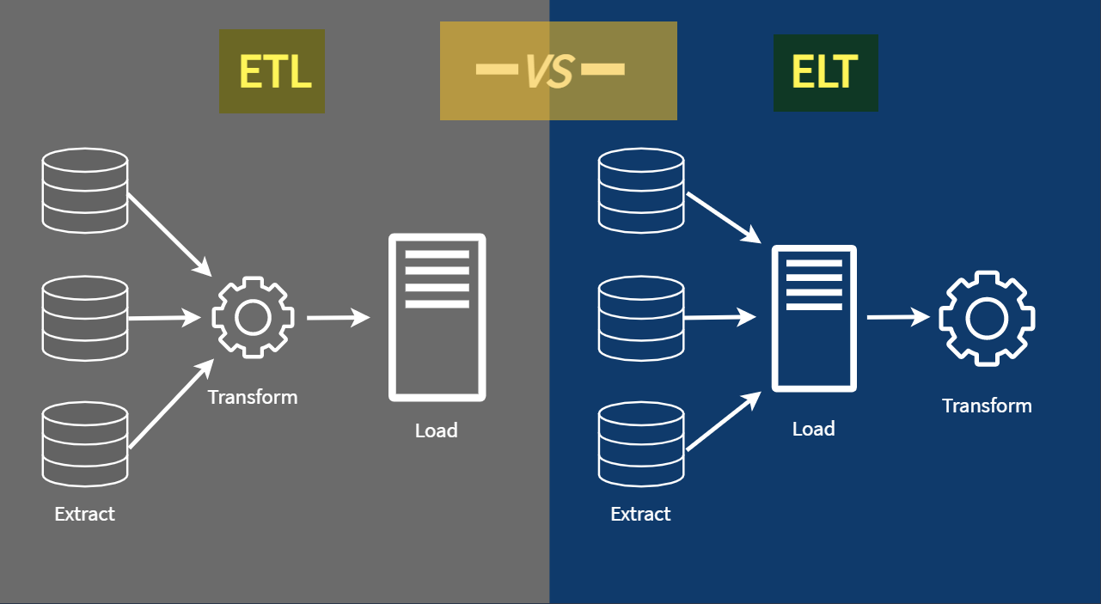
ETL VS ELT

Slide 9
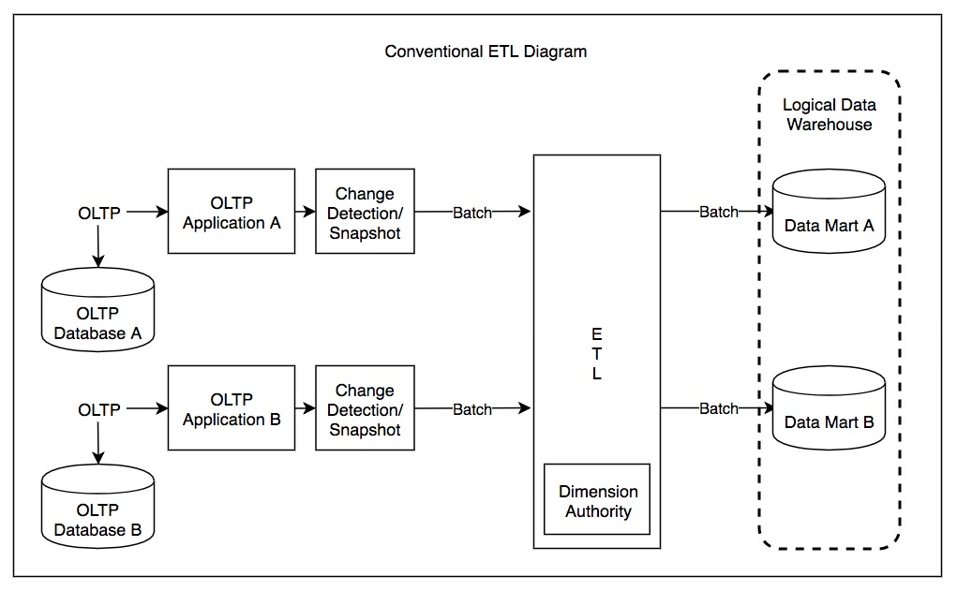
Demo of different ETL pipelines

Slide 10
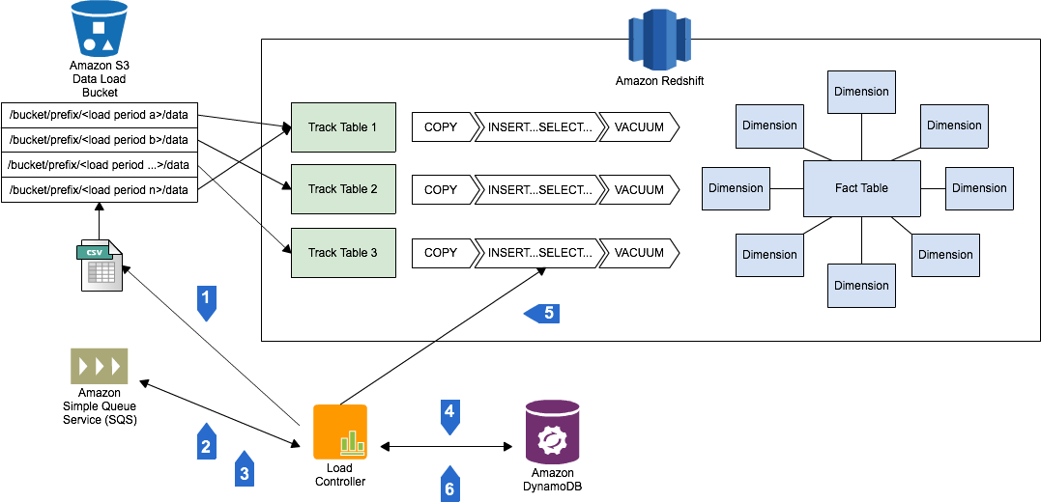

Slide 11
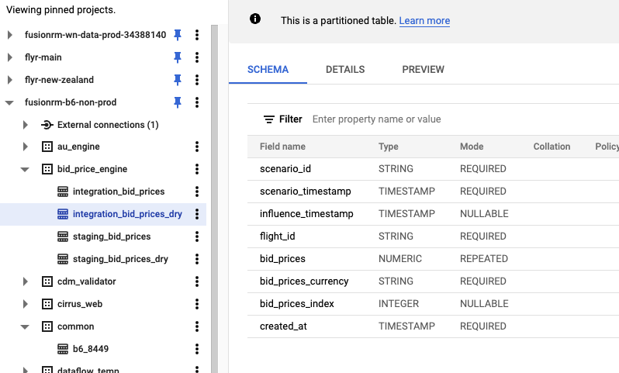
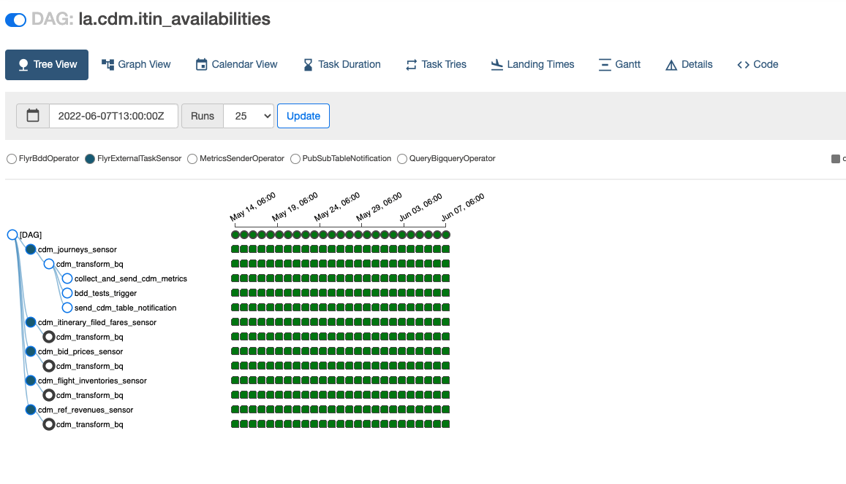
ETL pipeline

Slide 12
Data Visualization
Here are a set of simple steps for selecting appropriate data visualization:
Step 1: Identify your audience.
Step 2: Identify questions to be answered by your visualization.
Step 3: Think of possible constraints or challenges (e.g., budget limitations, the speed at which the study can be completed, or the dependability of your data) and ask the following questions:
Is my data reliable?
Is the value of the analysis greater than the cost?
How will I store my data?
Is the data owned or controlled by someone else?
Step 4: Select the appropriate visualization.

Slide 13
Data Visualization
Advantages and Limitations
Reporting, Monitoring, and Deciding

Slide 14
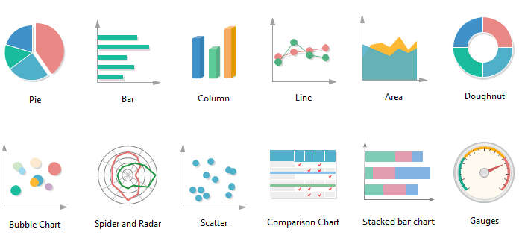
Data Visualization - Tools & Techniques
Types of charts
Image credit: https://medium.com

Slide 15
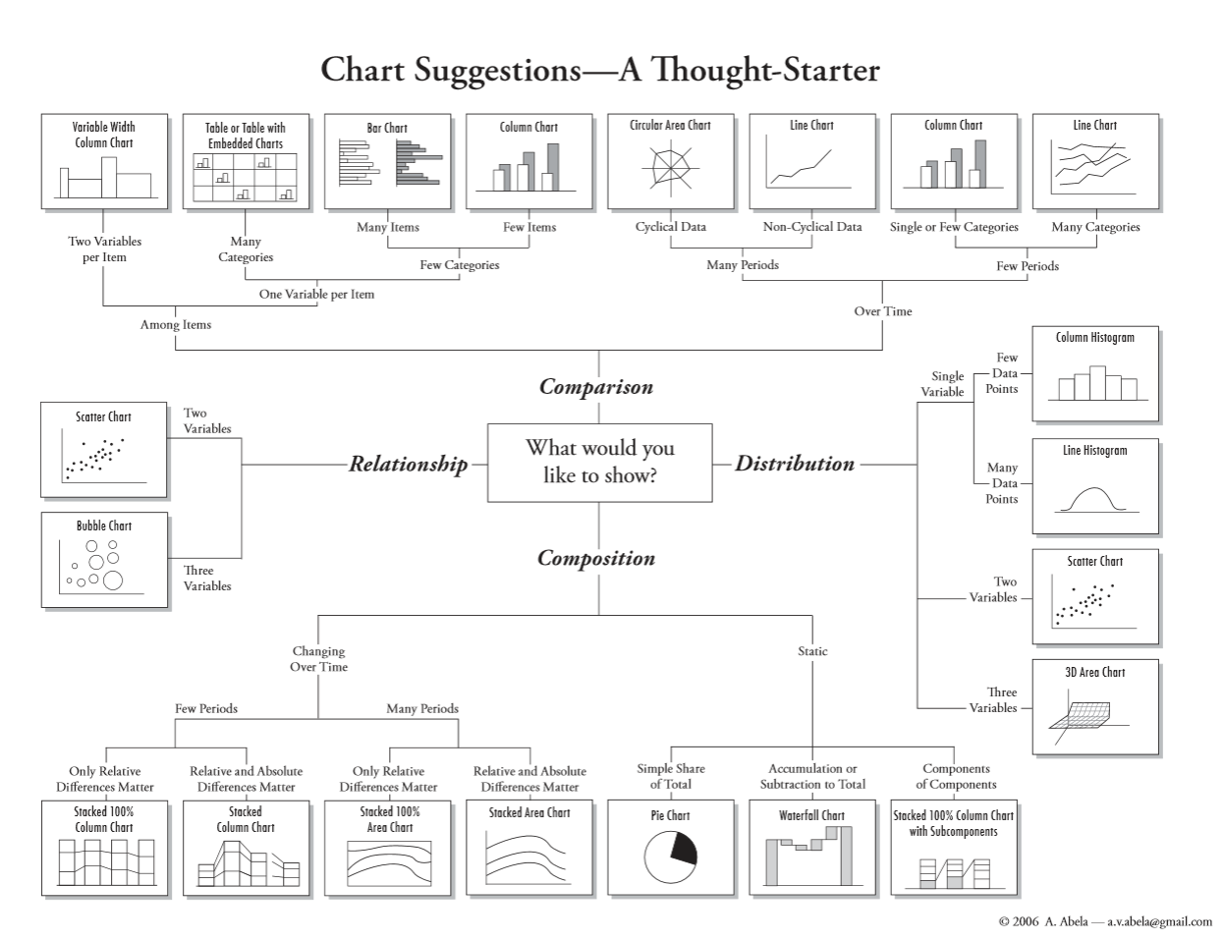
Data Visualization – The right tool for the job

Slide 16
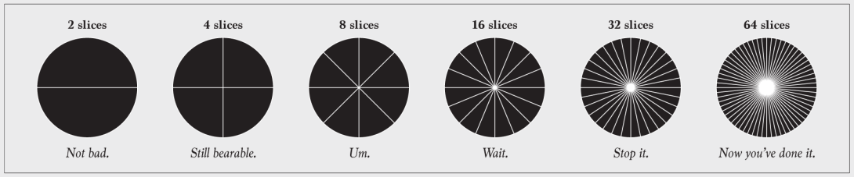
Pie Chart
What is "too many" slices though?
That's a judgement call, but if it's hard to tell that one slice represents twice the value as another or smaller slices start to look the same, it's time to scale back.
Consider clumping the smaller categories into a larger "Other" group.
The same goes for donut charts.

Slide 17
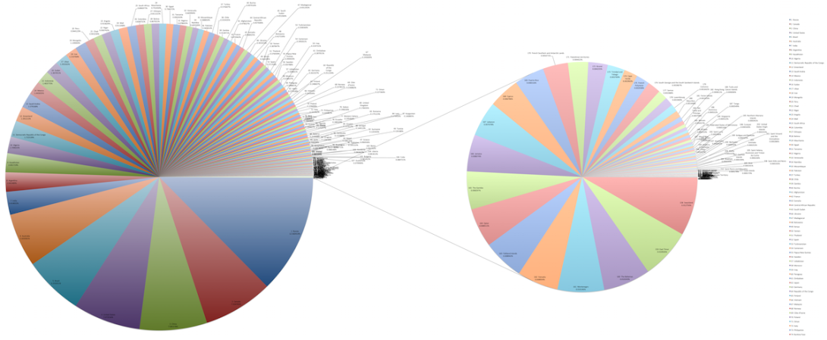
Pie Chart
Example
This set of pie charts comes by way of Wikipedia, and it shows the areas of countries.
Notes:
The chart on the left already has a lot of slices, but then there's a breakout pie chart for smaller countries that provides even more. There are a lot of ways to go about showing this data, such as a treemap, properly scaled symbols, or just a regular map. The meager pie chart just isn't built for datasets that are more than a handful of values.

Slide 18
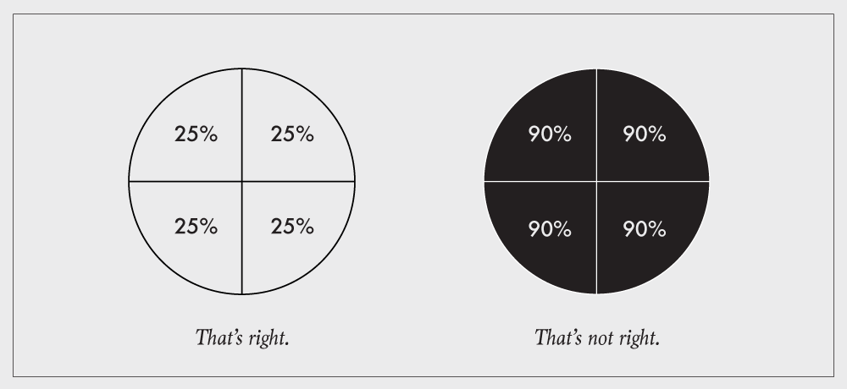
Respect the parts of a whole
Charts that represent parts of a whole should be used to show data that represents parts of a whole.
This includes stacked bar charts, stacked area graphs, treemaps, mosaic plots, donut charts, and pie charts.
Each section in these charts represents a separate, non-overlapping proportion.

Slide 19
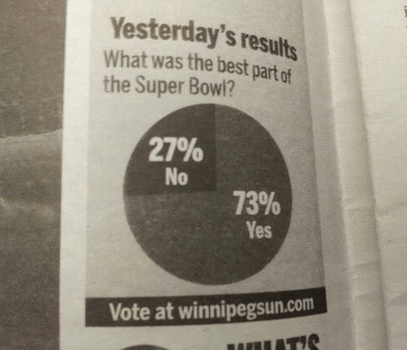
What is the question?

Slide 20
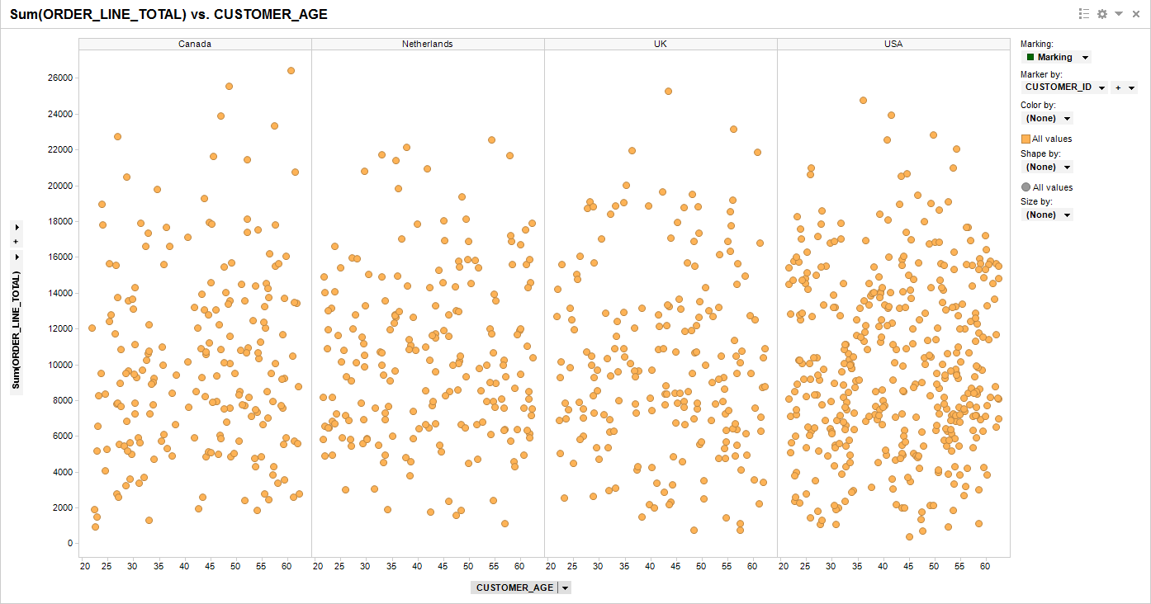
Scatter Plot: What is the story here?

Slide 21
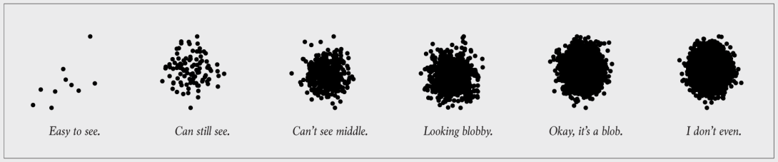
Scatter Plot: Say What?
This is the point of visualization. If you don't show the data, it defeats the purpose of the chart.
This often happens when you show too much data at once, and you obscure the area of interest.

Slide 22
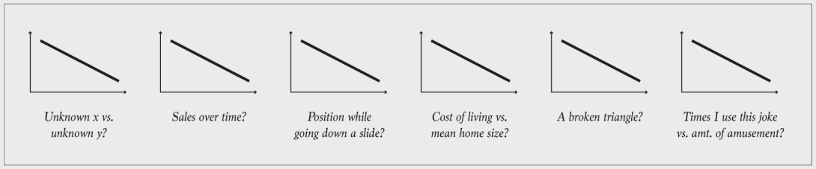
Line Chart: You have some explaining to do
When you "show the data", you encode it to shapes, colors, and geometries.
Need to the ability to decode back to the values. The classic example is unlabeled axes.
Sometimes encodings don't need to be explained. For example, your audience likely knows how to read a bar chart, so you don't have to explain that bar length represents values. But you do need to explain the data, namely the units and the subject at hand.

Slide 23
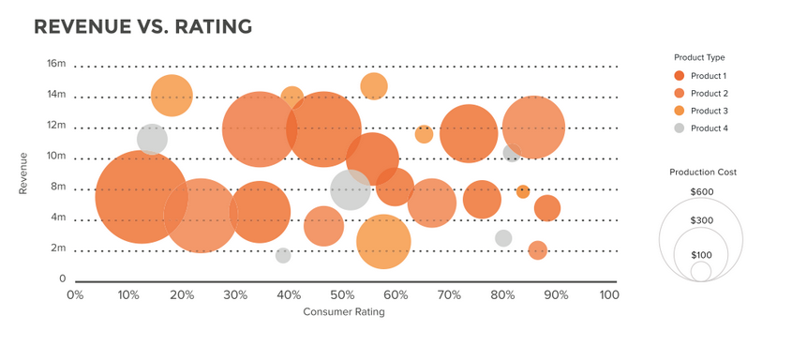
Bubble Plot

Slide 24
Final Project Check in
Grouping
Topic selection
Progress OR questions?
Schedule a meeting with each groups

Slide 25
Application Case:
Using predictive analytics for the oil and gas digital
One of the biggest data-driven use cases is for predictive maintenance, which utilizes time-series data from hundreds of sensors on equipment at each rig site, as well as maintenance records and operational information from various databases to generate rig data analytic lifecycles, adding predictive capabilities to a digital system to dramatically increase its insights to the oil spills.
Breakout rooms with small groups
How to solve the “Oil Spill” crises
Be prepared to share your summary with the class

Slide 26

Welcome to your new office

Slide 27
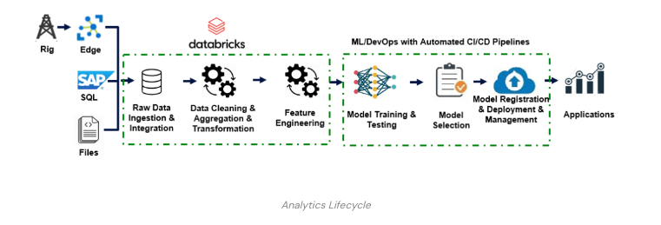
Discussion Questions
How mitigate risk in Oil spill and solve the “Oil Spill” crises using big data?
Each blow costs the Oil and Gas industry a Billion dollars? Can we avoid it? Can we see it coming and take action?
Each operating rig consists of thousands of sensors ? Sensor data can be used to analyze and reduce HSE (Health, Safety and Environment) risk considerably, how to store and make computation?
How to explore and communicate data analytics to the stakeholders?
What data exploration and visualization to use for time-series data?
What are the top metrics you can think about?
If using the dashboard below, try to communicate the result to the stakeholders.
Notes:
https://www.flutura.com/resources/articles/upstream-sensor-data-big-data-analytics-game-changer-in-oil-n-gas-industry
https://databricks.com/blog/2021/04/08/efficiently-building-ml-models-for-predictive-maintenance-in-the-oil-and-gas-industry-with-databricks.html

Slide 28
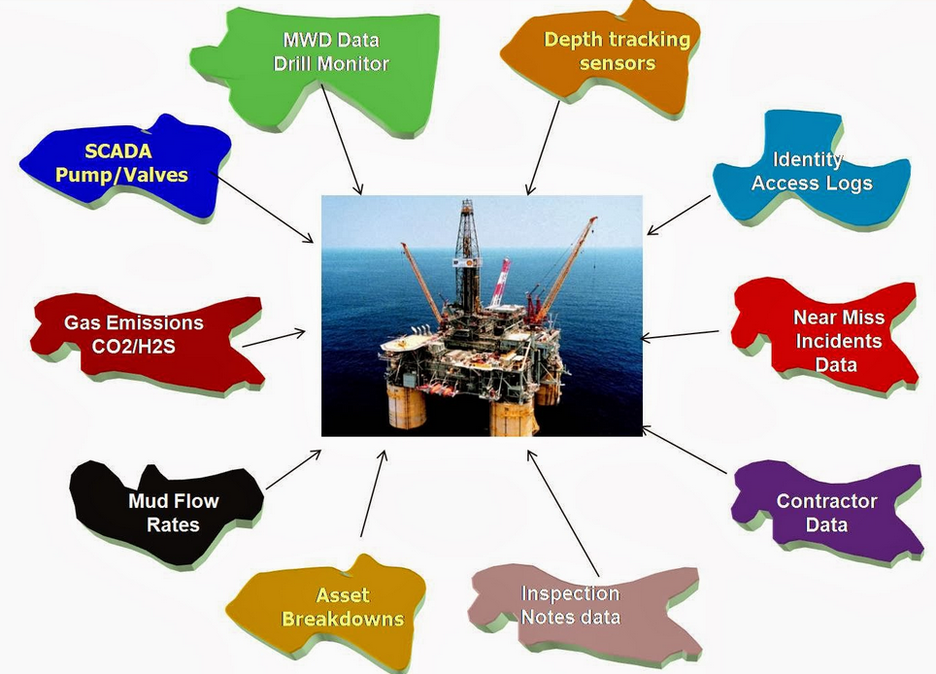
Data Sources

Slide 29
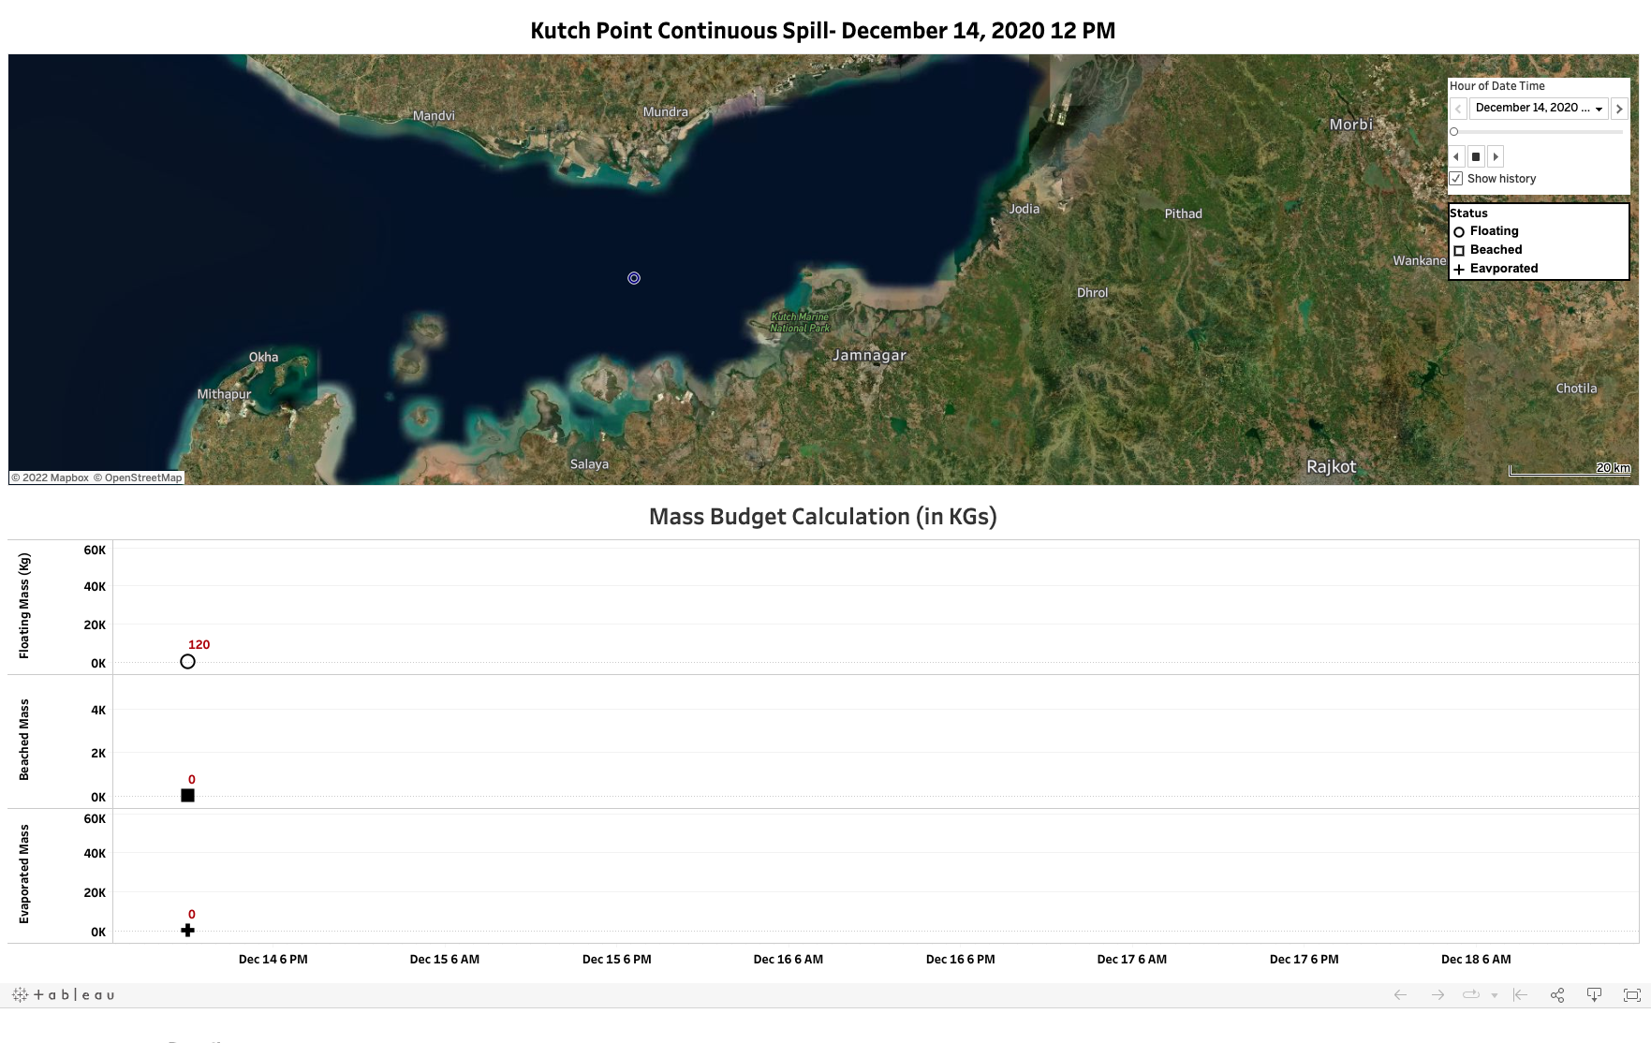
Notes:
https://public.tableau.com/app/profile/pajo/viz/Kutch_OilSPil/Dashboard1

Slide 30

Q&A
What questions and comments do you have?

